Slide 1

Pole attachmentS
Joint Accounting Conference may 12, 2017
Barry Barnett, Regulatory Assurance

Slide 2
Outline
Pole Attachment Update
Outliers
Contract Amendment Highlights
  Status
  Rate Approval Process
  Guideline Adjustment Scale
  Escalation Options
Approval Process
Guideline Adjustment Scale
DARS Page 36
Resources
Q&A
TVA Restricted Information - Deliberative and Pre-Decisional Privileged

Slide 3
Pole attachment update

Slide 4

Pole Attachment Update
Pole Attachment Rate Regulation
  14 LPCs have executed a contract amendment to implement their new pole attachment rate; remaining LPCs will implement no later than January 2018
  131 LPCs submitted their 2016 pole attachment templates
TVA Restricted Information - Deliberative and Pre-Decisional Privileged

Slide 5
outliers

Slide 6
Outliers
Maximum Valley Pole Attachment Rate
  $36 (1-Foot) and $39 (2-Foot)
Outlier Approach
  Analysis of all 154 LPCs’ pole rates using standard 50% depreciation rate
    One standard deviation above the mean from this data set
    50% depreciation represents the expected depreciation rate for a large set of data over a long period of time
  LPCs will continue to utilize actual data, including actual depreciation, to calculate their date; however, the LPC calculated rate will be subject to the established maximum rate
TVA Restricted Information - Deliberative and Pre-Decisional Privileged

Slide 7
Outliers
  Rationale for establishment and implementation of the maximum rate includes:
Depreciation rates – Applying the 50% depreciation to the full cost recovery formula results in neither the under nor over-collection of revenue. Attaching parties will not be burdened with the cost of new plant, and LPCs with low depreciation rates are enabled to collect needed revenue for plant replacement.
Limited historical reviews - TVA has not historically conducted detailed reviews of some key elements of the pole attachment rate calculation such as pole counts, pole costs, and numbers of attaching parties. The approach helps mitigate potentially less efficient LPC operations.
Rate variability – Significant variations in pole attachment rates among neighboring LPCs can be mitigated by applying this approach.
TVA Restricted Information - Deliberative and Pre-Decisional Privileged
Notes:
As part of the TVA Board’s 2016 adoption of the Determination on Regulation of Pole Attachment Rates, TVA has established a maximum valley pole attachment rate that LPCs may charge attaching parties
This approach uses fair and reasonable measures to mitigate the impact of TVA’s full cost recovery methodology on some LPCs and normalize depreciation for the assets. Rationale for the establishment and implementation of the maximum rate includes:
• Depreciation rates – Applying the 50% depreciation to the full cost recovery formula results in neither the under nor over-collection of revenue. Attaching parties will not be burdened with the cost of new plant, and LPCs with low depreciation rates are enabled to collect needed revenue for plant replacement.
• Limited historical reviews - TVA has not historically conducted detailed reviews of some key elements of the pole attachment rate calculation such as pole counts, pole costs, and numbers of attaching parties. The approach helps mitigate potentially less efficient LPC operations.
• Rate variability – Significant variations in pole attachment rates among neighboring LPCs can be mitigated by applying this approach.

Slide 8
Outliers
TVPPA’s Regulatory Advisory Group and Board had opportunity to review the outlier approach and provide feedback
  TVA may modify this approach and/or take other reasonable measures to ensure the approach is accurate and effectively accounting for LPC rates outside certain statistical parameters
Impacted LPCs
Rate outlier approach was shared with LPCs
Customer Delivery discussed, in detail, with the 41 impacted LPCs
TVA Restricted Information - Deliberative and Pre-Decisional Privileged
Notes:
As part of the TVA Board’s 2016 adoption of the Determination on Regulation of Pole Attachment Rates, TVA has established a maximum valley pole attachment rate that LPCs may charge attaching parties
This approach uses fair and reasonable measures to mitigate the impact of TVA’s full cost recovery methodology on some LPCs and normalize depreciation for the assets. Rationale for the establishment and implementation of the maximum rate includes:
• Depreciation rates – Applying the 50% depreciation to the full cost recovery formula results in neither the under nor over-collection of revenue. Attaching parties will not be burdened with the cost of new plant, and LPCs with low depreciation rates are enabled to collect needed revenue for plant replacement.
• Limited historical reviews - TVA has not historically conducted detailed reviews of some key elements of the pole attachment rate calculation such as pole counts, pole costs, and numbers of attaching parties. The approach helps mitigate potentially less efficient LPC operations.
• Rate variability – Significant variations in pole attachment rates among neighboring LPCs can be mitigated by applying this approach.

Slide 9
Contract amendment Highlights

Slide 10
Contract Amendment Highlights
  Contract Amendment Status
  TVPPA is working to provide TVA with additional input on the proposed contract amendment (expected in early June)
  Once that input is received, TVA will need time to review the amendment with Rates and Contracts, and then finalize (expected in July)
  Rate Approval
  The contract envisions LPC submitting its Pole Attachment Template to TVA within 15 days of submitting its annual report
  Following both the execution of the contract amendment and LPC’s submittal of its pole attachment template, TVA will provide LPC with a letter documenting its TVA-approved pole attachment rate.
  Beginning in 2018, between January 1 and March 31 of each year, TVA will provide LPC with its most updated TVA-approved pole attachment rate
    That rate will be used by LPC in contracts with all new and renewing parties
TVA Restricted Information - Deliberative and Pre-Decisional Privileged

Slide 11
Contract Amendment Highlights
  Guideline Adjustment Scale
  In instances where there is a variance between the current pole attachment rate and the TVA-approved pole attachment rate, then LPC must use the Guideline Adjustment Scale to transition to the TVA approved rate
TVA Restricted Information - Deliberative and Pre-Decisional Privileged

Slide 12
Contract Amendment Highlights
  Escalation Options
Once LPC’s Current Rate reaches the TVA-approved Pole Attachment Rate, after any necessary application of the Guideline Adjustment Scale, LPC must adjust its Pole Attachment Rate in accordance with either of the options below:
  Handy-Whitman Index*, on a monthly, semi-monthly, or yearly basis (as determined by agreement between LPC, Attaching Parties, or LPC’s electric, broadband, and any other legally-affiliated divisions)
    Rate escalation may not exceed the maximum rate that may be established by TVA
  The most recent TVA-approved pole attachment rate.
*Note: If adjustment of the pole attachment rate using the Handy-Whiteman Index results in a rate that exceeds the most recent TVA-approved pole attachment rate by 15% or more, then LPC must submit the Escalated Pole Attachment Rate to TVA for a new Pole Attachment Rate. In these cases, LPC will then use the new TVA-approved pole attachment rate in its agreements with those affected attaching parties.
TVA Restricted Information - Deliberative and Pre-Decisional Privileged

Slide 13
Rate Approval process

Slide 14
Rate Approval Process
Beginning in Fall 2017:
Pole Attachment template is due 15 days after DARS report is completed and submitted to TVA
Regulatory Assurance will verify / review template inputs and required documentation
Any modifications necessary will be addressed with the LPC to correct, etc.
Deep dive by Regulatory Assurance Analyst, if necessary
Approved rates will be provided to LPC between January and March 2018
TVA Restricted Information - Deliberative and Pre-Decisional Privileged

Slide 15
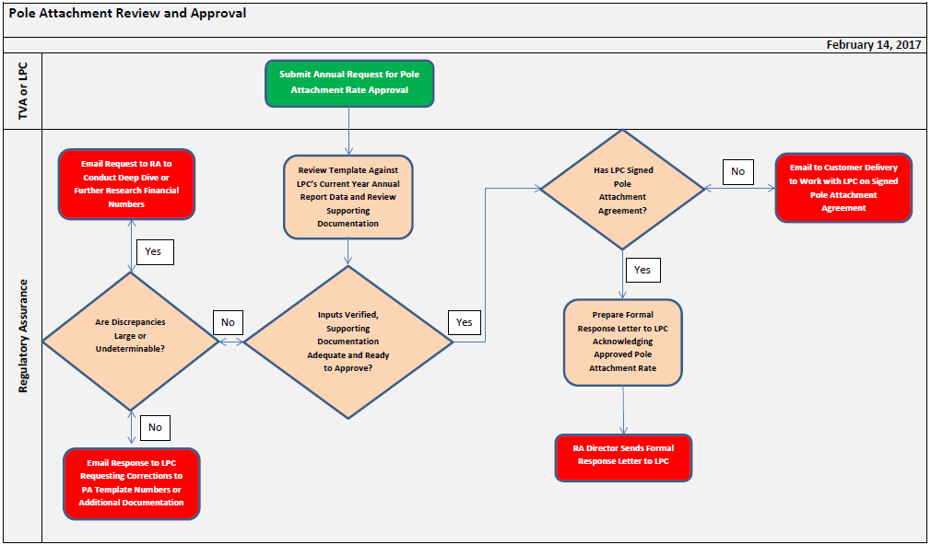
Rate Approval Process
TVA Restricted Information - Deliberative and Pre-Decisional Privileged

Slide 16
DARS Page 36

Slide 17
DARS Page 36 – Best Practices
2017 Annual Report Data Entry for DARS Page 36:
DARS Page 36 serves as the document of record for each LPC’s pole attachment data
  Enter a separate record for all attachers (including joint use)
  Fully complete all fields for each attacher
  If the LPC does not have a contract with an attacher – get one!
  Once DARS Page 36 has been filled out by the LPC, the information on it will roll forward each year and only require the LPC to update (versus enter it from scratch)
TVA Restricted Information - Deliberative and Pre-Decisional Privileged

Slide 18
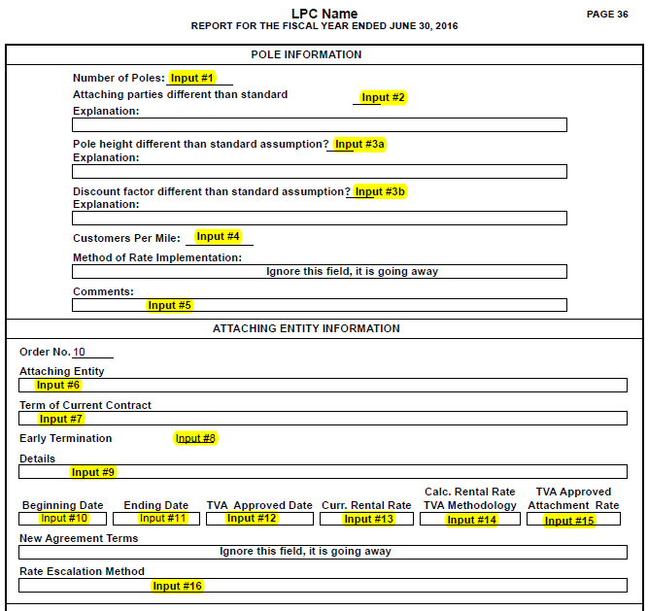
Data Inputs
DARS Page 36
DARS Page 36 requires LPC input for 16 values on page 1 (highlighted cells)
Standard – Rural/Urban
Default 37.5 ft. Can change with proper documentation
TVA Restricted Information - Deliberative and Pre-Decisional Privileged

Slide 19
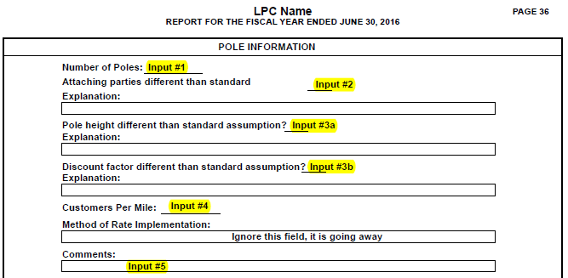
Pole Information
Input #1 – Number of Poles
No of distribution poles in Account 364
Input #2 – Attaching parties different from standard?
Enter N if using the Standard Assumption
Enter Y if using Probability Method or Actual System Data
Note: If answer is Yes, then LPC must provide documentation
Input #3a and Input #3b - Pole Height and Discount Factor different than standard assumption Y/N?
Enter N in both fields if using the default pole height/discount factor
Enter Y if using actual system data.
Note: If LPC is using actual system data for either input, they must use it for both inputs and provide documentation for both numbers to TVA.
DARS Page 36
TVA Restricted Information - Deliberative and Pre-Decisional Privileged

Slide 20
Pole Information (continued)
DARS Page 36
Input #4 – Customers per mile
Enter the LPC’s number of customers per mile.
Note: The number entered here determines which Standard Assumption option the LPC can use on their pole attachment template (Standard Assumption-Rural or Standard Assumption-Urban)
Input #5 – Comment
General comment field related to pole information
TVA Restricted Information - Deliberative and Pre-Decisional Privileged
Notes:
Standard Assumption Rural is defined as <= 40 customers per mile
Standard Assumption Urban is defined as > 40 customers per mile

Slide 21
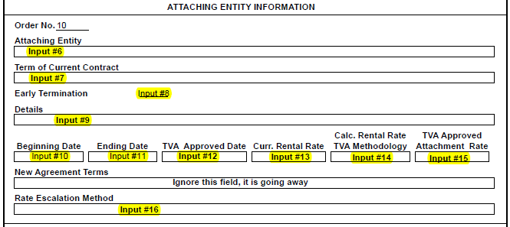
Attaching Entity Information
Input #6 – Attaching entity
NOTE: Enter ALL contracts with attaching parties (joint use, evergreen, term)
Enter the name of each attaching entity in a separate record (for example, A&T, Charter, Comcast, etc.)
Input #7 – Term of contract
Enter the term of the contract with the attaching entity and give indication if contract is Evergreen or Joint-Use. Some examples:
  Automatically renews every year (evergreen)
  10 years (joint use)
  10 year contract with 1st renewal for 5 years, can be renewed until 2027 (term)
DARS Page 36
TVA Restricted Information - Deliberative and Pre-Decisional Privileged

Slide 22
Attaching Entity Information
Input #8 – Early termination (Y/N)?
Can the contract be terminated early (Y/N)?of each attaching entity in a separate record (for example, A&T, Charter, Comcast, etc.)
Note: We expect there will be very few instances where the LPC cannot exit these contracts in certain conditions (such as nonpayment, for cause, etc.).
Input #9 – Details
Enter any other details about the contract and the details for early termination, such as:
  Early termination provisions are for cause and non-renewal, no other types of early out
  Cause and non-payment
  Can be terminated on the annual renewal date by either party with 60 days prior notice
  6 months notice
DARS Page 36
TVA Restricted Information - Deliberative and Pre-Decisional Privileged

Slide 23
Attaching Entity Info (Continued)
Input #10 – Beginning date
The beginning date of the agreement the LPC has in place with the attaching party
Input #11 – Ending date
The ending date of the agreement the LPC has in place with the attaching party
DARS Page 36
TVA Restricted Information - Deliberative and Pre-Decisional Privileged

Slide 24
Attaching Entity Info (Continued)
DARS Page 36
Input #12 – TVA Approved Date
The date TVA approved the LPC’s pole attachment rate
Input #13 – Current Rental Rate
The rate the LPC is charging the attacher according to the current agreement in place
TVA Restricted Information - Deliberative and Pre-Decisional Privileged

Slide 25
Attaching Entity Info (Continued)
Input #14 – Calculated Rental Rate - TVA Methodology
Enter the calculated pole attachment rate after it is verified by TVA
Input #15 – TVA Approved Rate
Enter the TVA approved pole attachment rate
Note: This will either be the calculated rate used as Input #14, or the TVA rate cap)
Input #16 – Rate Escalation Method
Enter the method of escalation (Handy Whitman or TVA Pole Attachment Template) and also indicate if LPC is using the Guideline Adjustment Scale to transition rate
DARS Page 36
TVA Restricted Information - Deliberative and Pre-Decisional Privileged

Slide 26
Resources
Regulatory Assurance Staff
Barry Barnett – 865-632-2107; jbbarnett@tva.gov
Regulatory Assurance Field Accountants
Customer Delivery Staff
OnlineConnections
Pole Attachment Tool Kit
Pole Attachment Templates and Instructions
Tips, Guidance, Resources
TVA Restricted Information - Deliberative and Pre-Decisional Privileged
Notes:
TVA staff is available to assist you, please reach out to myself, your field accountant, or your customer service manager.
You can also find today’s presentation and other helpful information on the Regulatory Assurance page of TVA’s OnlineConnections.
Please take a copy of the “one-pager” provided for you at ???? (your tables/at the door) which includes TVA’s contact information, list of resources, and helpful hints.

Slide 27
Questions?
TVA Restricted Information - Deliberative and Pre-Decisional Privileged

Slide 28
Thank you
TVA Restricted Information - Deliberative and Pre-Decisional Privileged

